Slide 1
THIS IS YOUR PRESENTATION TITLE

Slide 2

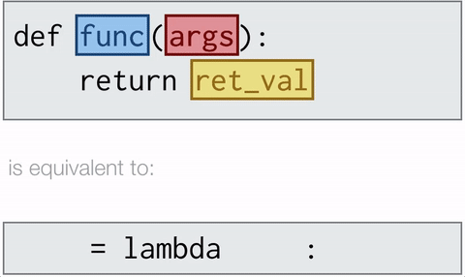
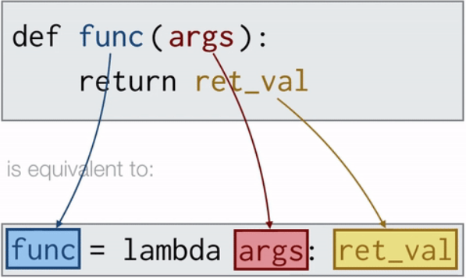
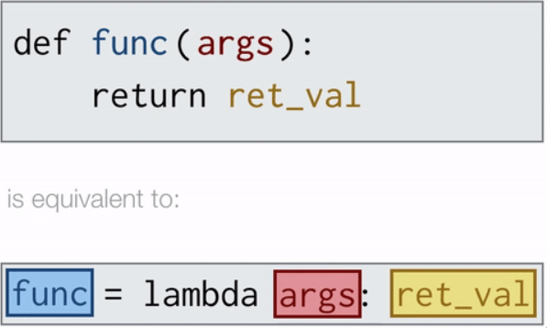
Lambda
●Lambda functions are anonymous, i.e. to say they have no names
●The lambda is a keyword and a one-line function
●No def or return keyword and arguments can be many expression is only one.
●Lambdas are used when a function is needed temporarily and used inside another function such as filter, map and reduce.
Why Lambda?
●Using lambda function, you can define a function and call it immediately.
●In our understanding lambda functions and user defined functions work exactly same with the exception that less coding in lambda.
Simple lambda function:
square = lambda x : x**2
cube = lambda x : x ** 3

Slide 3
Lambda Sample Code along with other functions
Along with Reduce:
my_list = list(range(1,101,1))
print(ft.reduce(lambda x,y: x+y ,my_list))
Over Usage of Lambda:
import functools.reduce
numbers = [2, 1, 3, 4, 7, 11, 18]
total = reduce(lambda x, y: x + y, numbers)
Above can be written as
numbers = [2, 1, 3, 4, 7, 11, 18]
total = sum(numbers) → Sum() in-built function
Along with Filter:
number_list = range(-5, 5)
less_than_zero = list(filter(lambda x: x < 0, number_list))
print(less_than_zero)
Usage of a variable without prior definition will throw an error for e.g. :
div = lambda a ,d : a/c → c is not defined
Along with Map:
number = (11, 21, 30, 34)
squared = list(map(lambda x: x**2, number))

Slide 4
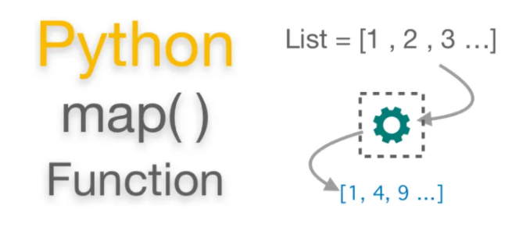
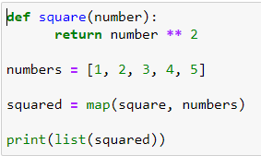
Map
What is map()
● It is a built-in function that allows you to process and transform all the items in an iterable without using an explicit for loop.
● map() is useful when you need to apply a transformation function to each item in an iterable and transform them into a new iterable.
Syntax
map(function, iterable[, iterable1, iterable2,..., iterableN])
How does it work
● map() applies function to each item in iterable in a loop and returns a new iterator that yields transformed items on demand.
●This first argument to map() is a transformation function.

Slide 5
Filter
INPUT:
LIST
Filtering a list to create another List
OUTPUT:
Filtered List
Is equivalent to expression:
(item for item in iterable if function(item))
1
0
If
Num == 1
1
FILTER
1
1
0
.
.
.
.
.
.
Python Usage:
filtered_list = list(filter(condition, input_list))
“condition”: Can be function/lambda
Code for above diagram:
input_list = [1,0,1,0,1,1,0,1]
filtered_list = list(filter(lambda a:a==1, input_list))
print(filtered_list)
O/P:
[1, 1, 1, 1, 1]
1
1

Slide 6
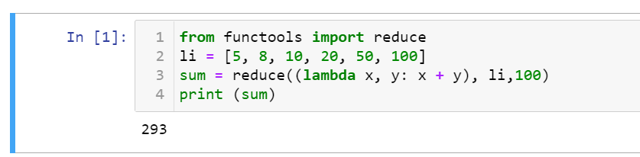
Reduce
What is reduce
Python’s reduce() is a function that implements a mathematical technique called Folding or reduction .
reduce() is useful when you need to apply a function to an iterable and reduce it to a single cumulative value.
How does it work
Syntax
1.Apply a function (or callable) to the first two items in an iterable and generate a partial result.
reduce(function, sequence[, initial]) -> value
[
]
2.Use that partial result, together with the third item in the iterable, to generate another partial result.
5
8
10
20
50
100
+
3. Repeat the process until the iterable is exhausted and then return a single cumulative value.
+
+
113
123
+
Sample program
100
+
143
+
193
293

Slide 7

Thank you for your attention

